Slide 1
PSG COLLEGE OF TECHNOLOGY
DEPARTMENT OF ELECTRONICS AND COMMUNICATION ENGINEERING
19L820 - PROJECT WORK II
TOPIC : OUTDOOR BLIND VISION ENHANCEMENT: A SMART ASSISTIVE TECHNOLOGY PROJECT FOR INDIVIDUALS WITH VISUAL IMPAIRMENTS
GUIDED BY
Dr D SIVARAJ
Assistant Professor
Department of ECE
BATCH - 12
Deepika E - 20L106
Kavinraj S - 20L121 Subhashini J - 20L146
Suresh Kumar R - 20L147

Slide 2
WEEK 1

Slide 3
OBJECTIVE
The objective of the proposed work is to fulfill the needs:
To relay real-time location updates ensure that visually impaired individuals stay informed about their current whereabouts during their journey.
To develop a system capable of recognizing and announcing the bus number, allowing users to identify the correct bus.
To recognize and inform users through voice about the bus route, ensuring they board the correct bus heading to their destination.

Slide 4
BLOCK DIAGRAM
CAMERA
PROCESSING UNIT
VOICE
GPS

Slide 5
WORK PROGRESS
NUMBER RECOGNITION:
Image Capture: Capture or load an image containing numbers.
Preprocessing with OpenCV: Resize, convert to grayscale, and apply thresholding.
Number Recognition with EasyOCR: Utilize EasyOCR for recognizing numbers in the preprocessed image.
Text-to-Speech with pyttsx 3: Implement pyttsx 3 to convert recognized numbers to speech.

Slide 6
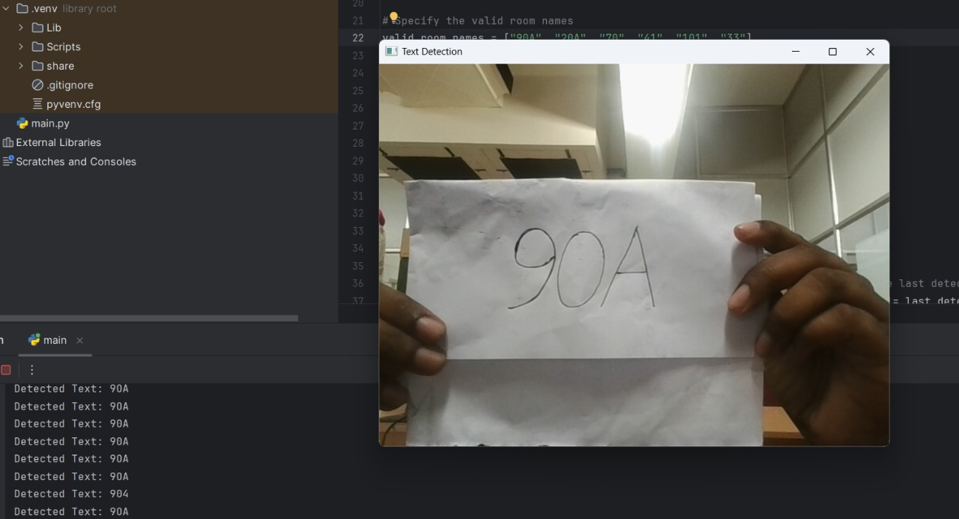
WORK PROGRESS
NUMBER RECOGNITION:
In the image '90A,' text is recognized and detected using advanced tools such as EasyOCR and OpenCV

Slide 7
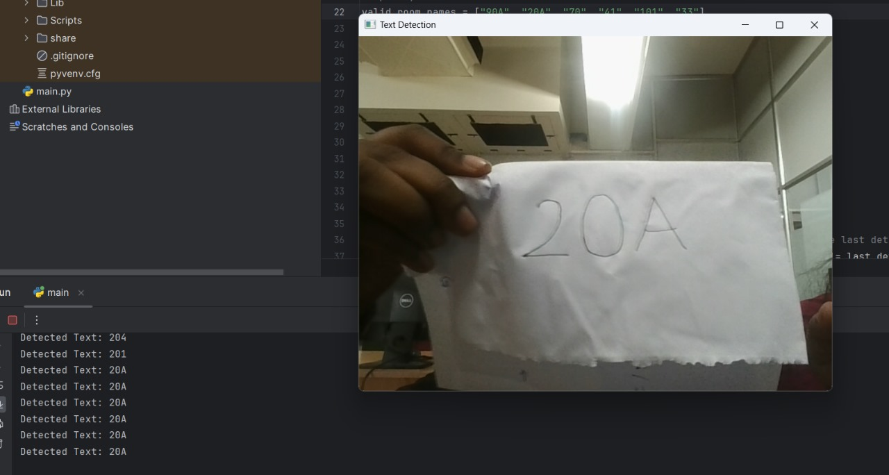
WORK PROGRESS
NUMBER RECOGNITION:
In the image '20A,' text is recognized and detected using advanced tools such as EasyOCR and OpenCV

Slide 8
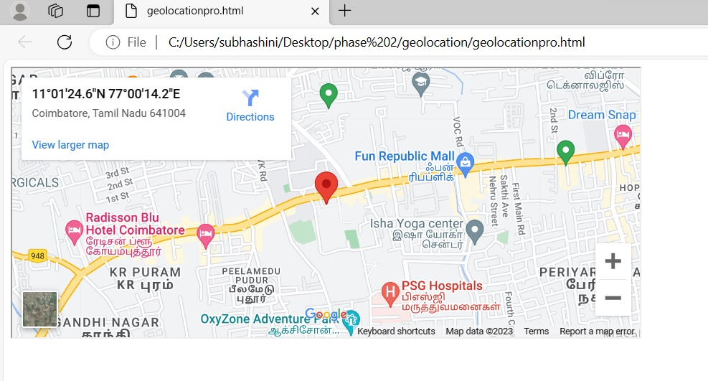
WORK PROGRESS
CURRENT LOCATION IDENTIFICATION
Implemented the Geolocation API in Java to accurately determine and retrieve the current geographical location.

Slide 9
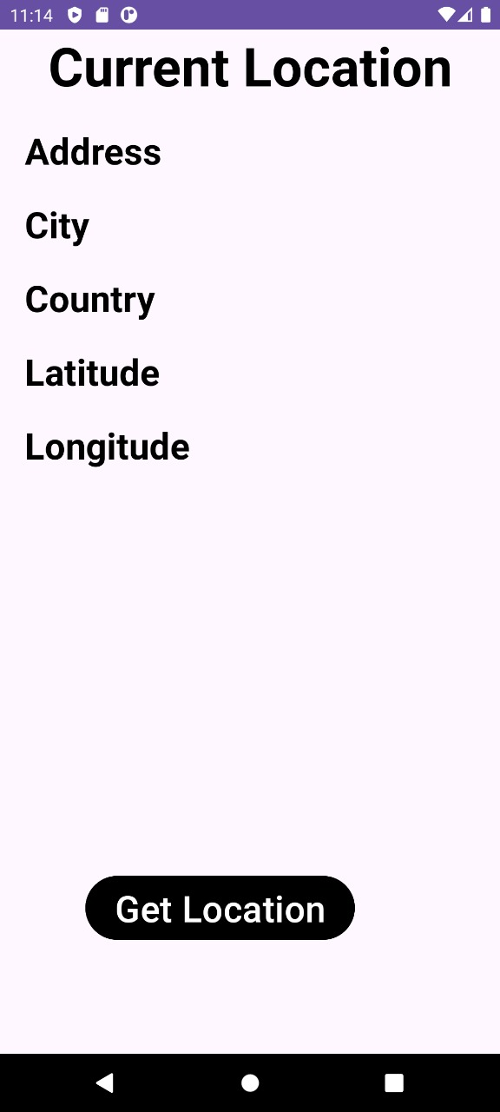
WORK PROGRESS
CURRENT LOCATION IDENTIFICATION - APP
Initiated the development of a mobile application within the Android Studio environment with the primary objective of accurately identifying and displaying the user's current geographical location.
Established the project foundation by configuring the necessary settings and dependencies in Android Studio, ensuring a robust development environment for creating a location-based application.

Slide 10
THANK YOU

Slide 11
WEEK 0

Slide 12
AGENDA
Need for the Project
Objective
Problem statement
Literature survey
Work progress
References

Slide 13
NEED FOR THE PROJECT
This project addresses the need for visually impaired individuals to independently navigate in outdoor environments.
It focuses on providing real-time information about their location and assisting in identifying buses, bus numbers,obstacles,routes,etc.,
The project aims to enhance safety, accessibility to public transportation, and overall quality of life for visually impaired individuals.

Slide 14
PROBLEM STATEMENT
USE CASE
HOME
WORKPLACE
Consider a blind person from HOME(Vilankurichi Road,Peelamedu) travel to WORKPLACE(Somanur via karumathampatti) in Public Transport.
Needs to travel from HOME to BUS STOP independently.
Location guidance helps them to reach the peelamedu bus stop from home.
Towards home to bus stop locations of the important landmarks should be known, while walking towards bus stop.

Slide 15
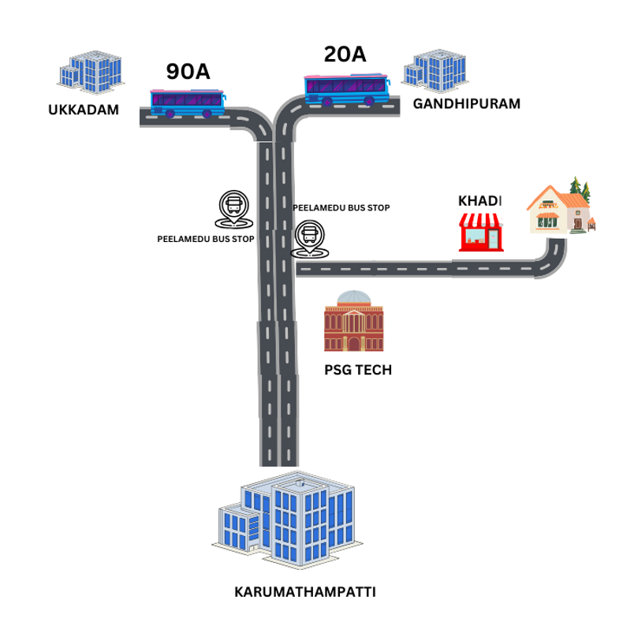
PROBLEM STATEMENT
USE CASE
Once they reach bus stop, The Bus route numbers 20A(Gandhipuram to Karumathampatti) and 90A(Ukkadam to Karumathampatti) stops at peelamedu bus stop.
Among several buses crossing , they need to identify the Bus and the Bus route reaching the destination karumathampatti.

Slide 16
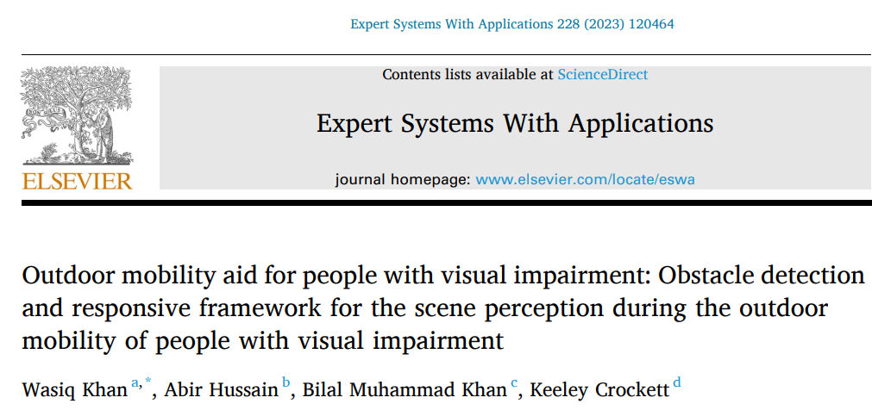
LITERATURE SURVEY - PAPER 1

Slide 17
LITERATURE SURVEY - PAPER 1
TITLE : Outdoor mobility aid for people with visual impairment: Obstacle detection and responsive framework for the scene perception during the outdoor mobility of people with visual impairment
PAPER | PROPOSED METHODOLOGY | TOOLS USED | REMARKS
Wasiq Khan, Abir Hussain et al, Expert Systems with Applications,Volume 228,2023 | A transfer learning approach was developed utilising well established deep convolutional neural network structures of YOLO v5 and Mask R-CNNs based on a custom target dataset for real-time identification of 8 classes of objects (advertisement board, e-Scooter, wheel bin, trash bag, car, person, bollard, and bench). | AMD Ryzen Threadripper 2990WX 32-Core Processor 3.00 GHz, 128 GB RAM) | The ObDtM approach was developed for the objects of 8 different classes, the proposed model can be easily generalised by expanding its identification capability for other object classes with considerably moderate tuning for newly acquired information, thus enhancing its applicability domain.

Slide 18
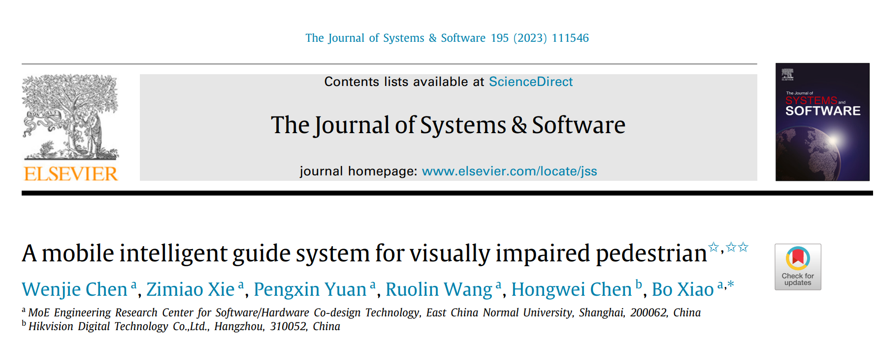
LITERATURE SURVEY - PAPER 2

Slide 19
LITERATURE SURVEY - PAPER 2
TITLE : A mobile intelligent guide system for visually impaired pedestrian
PAPER | PROPOSED METHODOLOGY | TOOLS USED | REMARKS
Wenjie Chen, Zi Miao Xie et al,Journal of Systems and Software, Volume 195, 2023 | The MobileNet model fine-tuned by transfer learning is used to perform feature extraction on overlapping grids. Single Shot MultiBox Detector (SSD) is then used for TWSI detection. The user’s position is determined by the Score Voting algorithm, and corresponding guide information is given. | Smartphones is used as identification and analysis tools for the system | The system is able to achieve high accuracy and real-time guide on both real tactile paving and stickers..

Slide 20
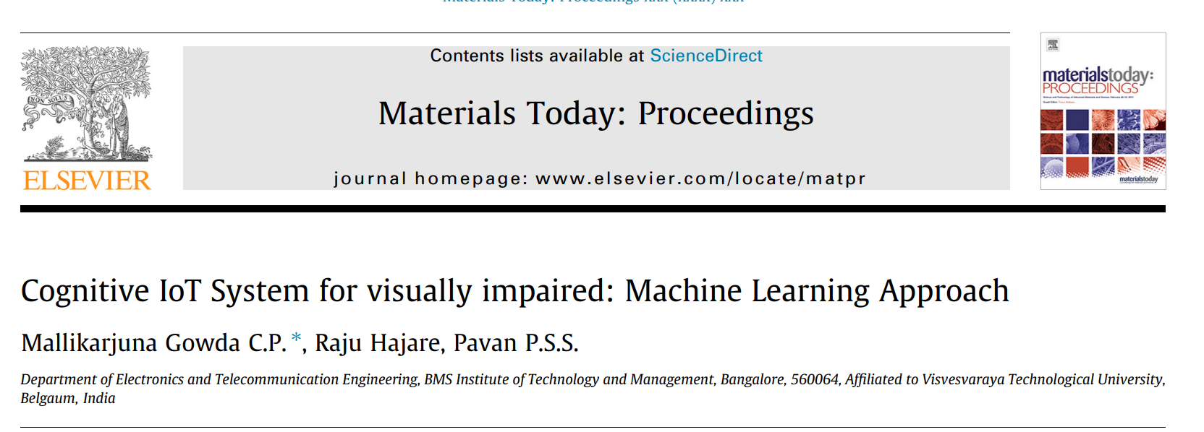
LITERATURE SURVEY - PAPER 3

Slide 21
LITERATURE SURVEY - PAPER 3
TITLE : Cognitive IoT System for visually impaired: Machine Learning Approach
PAPER | PROPOSED METHODOLOGY | TOOLS USED | REMARKS
Gowda C.P. Mallikarjuna et al, Materials Today: Proceedings,Volume 49, Part 3, 2022 | The proposed system helps the visually impaired persons to carry out the object recognition along with self-navigation, negotiating a crowd, negotiating train stations or bus stations and even in recognition of moving vehicle or static vehicle at a distance with the help of Tensor Flow Machine Learning Framework | Raspberry Pi 3 Speaker Raspberry Pi Camera | A cost-effective visual assistance system for object recognition to a visually impaired using IoT, Machine Learning and Embedded Technologies. This system provides assistance to the visually impaired persons in the environments that they operate in

Slide 22
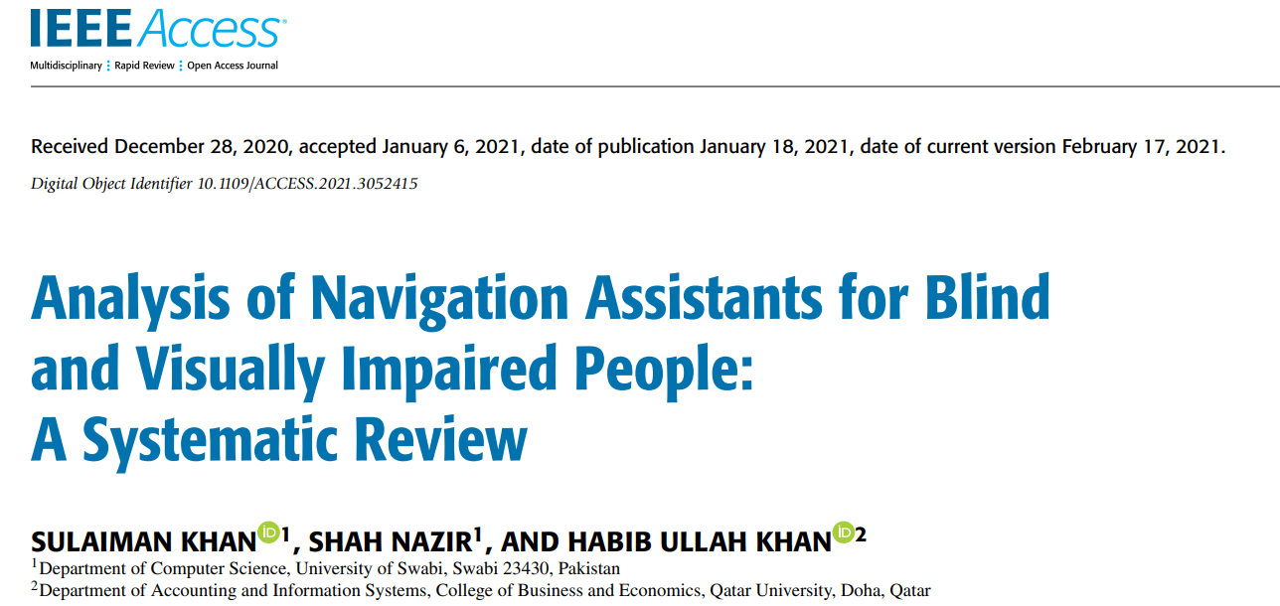
LITERATURE SURVEY - PAPER 4

Slide 23
LITERATURE SURVEY - PAPER 4
S. Khan, S. Nazir and H. U. Khan, "Analysis of Navigation Assistants for Blind and Visually Impaired People: A Systematic Review," in IEEE Access, vol. 9, pp. 26712-26734, 2021, doi: 10.1109/ACCESS.2021.3052415.
LEARNING OUTCOME
The paper examines challenges in developing navigation tools for blind and visually impaired individuals.
It reviews historical and modern approaches, identifying limitations in current technologies. Through a systematic analysis of 191 relevant articles from 2011 to 2020, the paper aims to guide the development of improved smart assistants for BVIPs, with a focus on safety.
The research has practical implications for reducing fatalities and major injuries among BVIPs by advancing navigation assistance technology.

Slide 24
WORK PROGRESS
NEED 1 - Where I am?
LOCATION IDENTIFICATION:
TO DO:
To find the current location of the user and to direct the visually impaired to walk in the right direction.
METHOD PLANNED:
12 location points have been collected in order to check if the user is going in the right direction from his home to bus stop.
The map can be integrated from the ISRO developed public application NAVIC or we can make use of Google API.

Slide 25
WORK PROGRESS
NEED 1 - Where I am?
NAVIC APPLICATION:
Smart safety app for fisherman in India.
To check the current live location of the fisherman.
To check the current position of the fisherman from the international maritime boundary.
Works completely offline.
Specifications required for NAVIC application, Qualcomm processor (snapdragon 460,662)

Slide 26
WORK PROGRESS
NEED 2 - What is around me?
TO DO:
To detect the objects particularly bus using Image classification algorithms.
To recognize the bus numbers from the detected bus image using Text Recognition algorithms.
To find the Bus routes of that detected bus with the help of predefined database that maps Bus number to Bus Routes.

Slide 27
WORK PROGRESS
NEED 2 - What is around me?
METHOD PLANNED:
Transfer Learning:
One of the pre-trained models of large datasets such as ImageNet or COCO or Google Open Images has to be chosen.
Our own custom dataset of local bus images will be collected.
CNN architecture like ResNet or MobileNet will be used to learn features from those large datasets.

Slide 28
WORK PROGRESS
NEED 2 - What is around me?
METHOD PLANNED:
Bus Detection:
YOLO (You Only Look Once) or SSD (Single Shot Multibox Detector) or Faster R-CNN can be used to detect the bus in the image frame.
Text Localization
EAST (Efficient and Accurate Sense Text Detector) or CRAFT (Character Region Awareness for Text Detection) techniques can be used to achieve character-level bounding boxes.

Slide 29
WORK PROGRESS
NEED 2 - What is around me?
METHOD PLANNED:
Bus Number Recognition:
OCR (Optical Character Recognition) modules from Pytesseract can be used to detect the bus numbers in the detected buses.
Bus Route Recognition:
Separate dataset that maps Bus numbers with Bus Routes can be used to recognize the bus routes of the detected bus numbers.

Slide 30
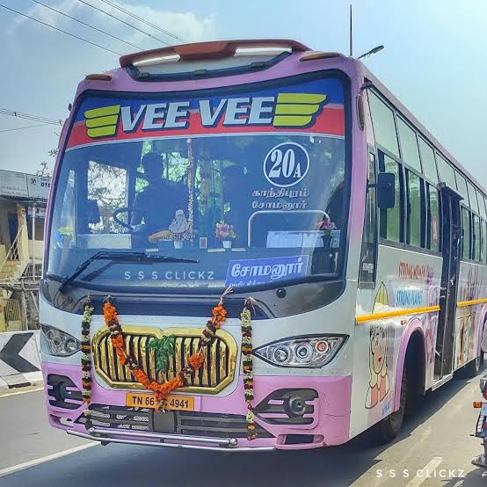
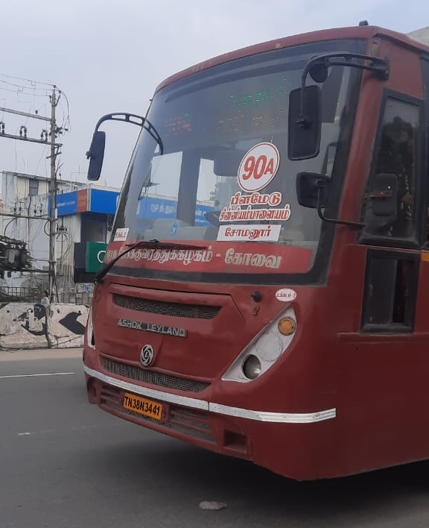
CUSTOM DATASET
20A bus( Gandhipuram to Somanur) which passes through peelamedu and reaches karumathampatti.
90A ( ukkadam to Somanur) also crosses peelamedu to reach karumathampatti.

Slide 31
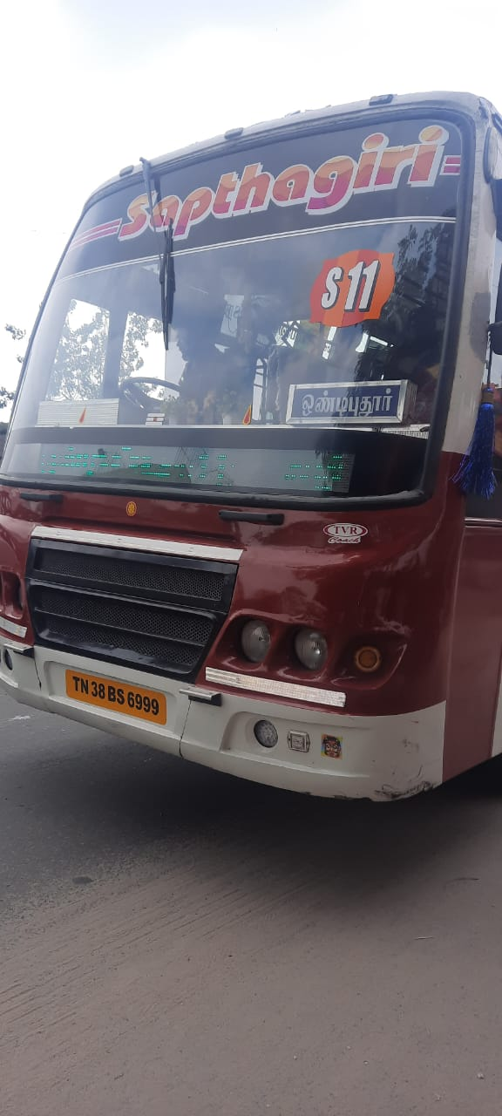
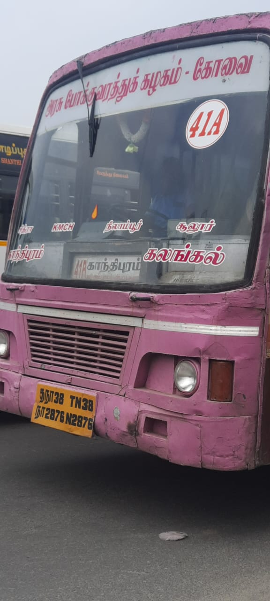
CUSTOM DATASET
41A which crosses peelamedu but this route doesn’t reach karumathampatti.
S11 bus goes to ondipudur bus doesn’t go karumathampatti.

Slide 32
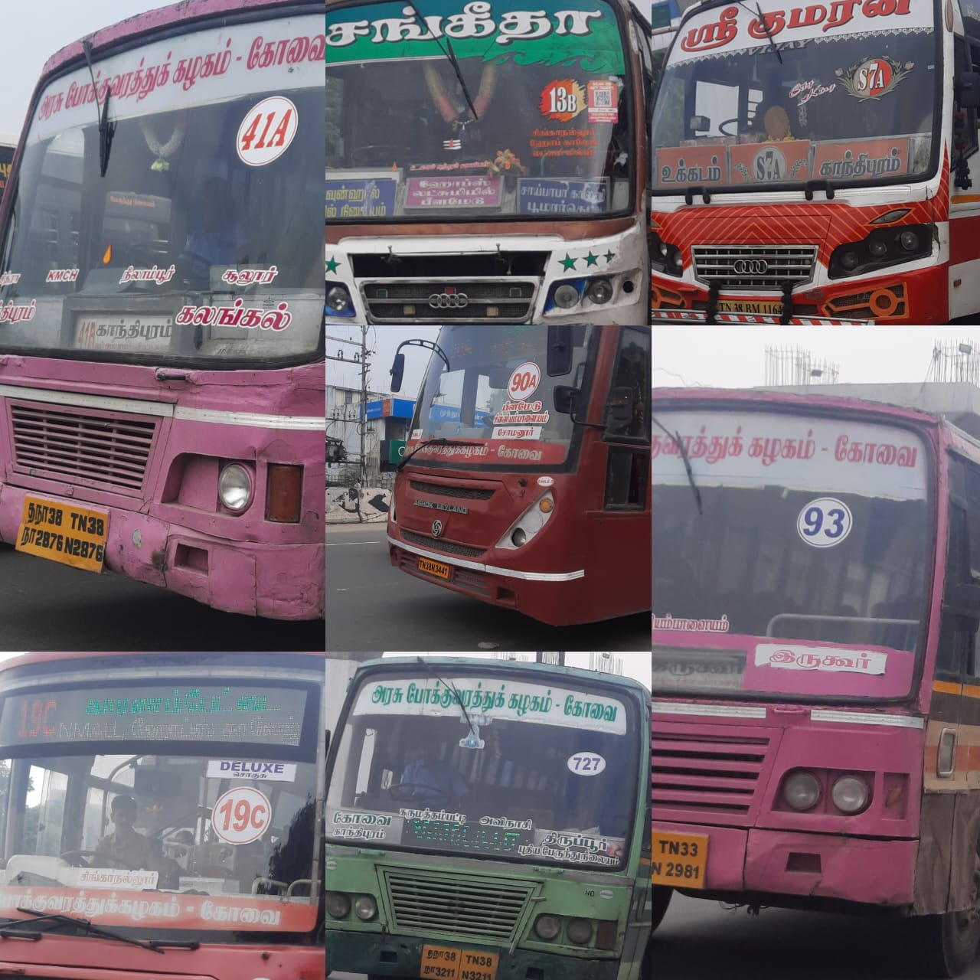
CUSTOM DATASET
We are focusing only on 90A/20A to reach Karumathampatti and ignoring all other buses

Slide 33


WORK PROGRESS
NEED 3 - How do I know?
IMAGE TO TEXT CONVERSION:
Python modules : pytesseract

Slide 34
WORK PROGRESS
NEED 3 - How do I know?
TEXT TO VOICE CONVERSION:
From the retrieved text from the image, that particular text is converted in to voice using gTTs and playsound module available in python.
Also the gTTs module, enables to convert the text into any language including tamil.
WhatsApp Audio 2023-12-18 at 07.47.17_2f7fbaca.dat.unknown

Slide 35
REFERENCES
[1] Wasiq Khan, Abir Hussain, Bilal Muhammad Khan, Keeley Crockett, “Outdoor mobility aid for people with visual impairment: Obstacle detection and responsive framework for the scene perception during the outdoor mobility of people with visual impairment” ,Expert Systems with Applications,Volume 228,2023,120464,ISSN 0957-4174
[2] Wenjie Chen, Zi Miao Xie, Pengxin Yuan, Ruolin Wang, Hongwei Chen, Bo Xiao, ”A mobile intelligent guide system for visually impaired pedestrian”,
Journal of Systems and Software, Volume 195, 2023, 111546, ISSN 0164-1212
[3] Gowda C.P. Mallikarjuna, Raju Hajare, P.S.S. Pavan,”Cognitive IoT System for visually impaired: Machine Learning Approach”, Materials Today: Proceedings,Volume 49, Part 3, 2022, Pages 529-535, ISSN 2214-7853.
[4] S. Khan, S. Nazir and H. U. Khan, "Analysis of Navigation Assistants for Blind and Visually Impaired People: A Systematic Review," in IEEE Access, vol. 9, pp. 26712-26734, 2021, doi: 10.1109/ACCESS.2021.3052415.

